Slide 1

Finding the Right Laptop Made Easy…

Slide 2



The Problem
Too many options, specs, and price points
1
Finding the Right Laptop is Hard
2
3
Users often overpay or buy underpowered devices
4
Tech jargon overwhelms casual users

Slide 3




Our Solution
Meet Lapick
A smart AI-driven web app
Matches users with the best laptop deals
Personalized recommendations based on your needs and budget.

Slide 4



How It Works …
1
2
3
4
The user inputs their needs (e.g. gaming, work, editing)
Recommends optimized laptops from reliable sources
How Lapick Finds Your Perfect Match
Fine-tuned LLM interprets specs & preferences

Slide 5



Tech Stack
Powered by a Solid Tech Stack
Frontend: Next.js, React, JavaScript
Backend: Node.js, Python
AI Layer: Fine-tuned LLM (Language Model)

Slide 6

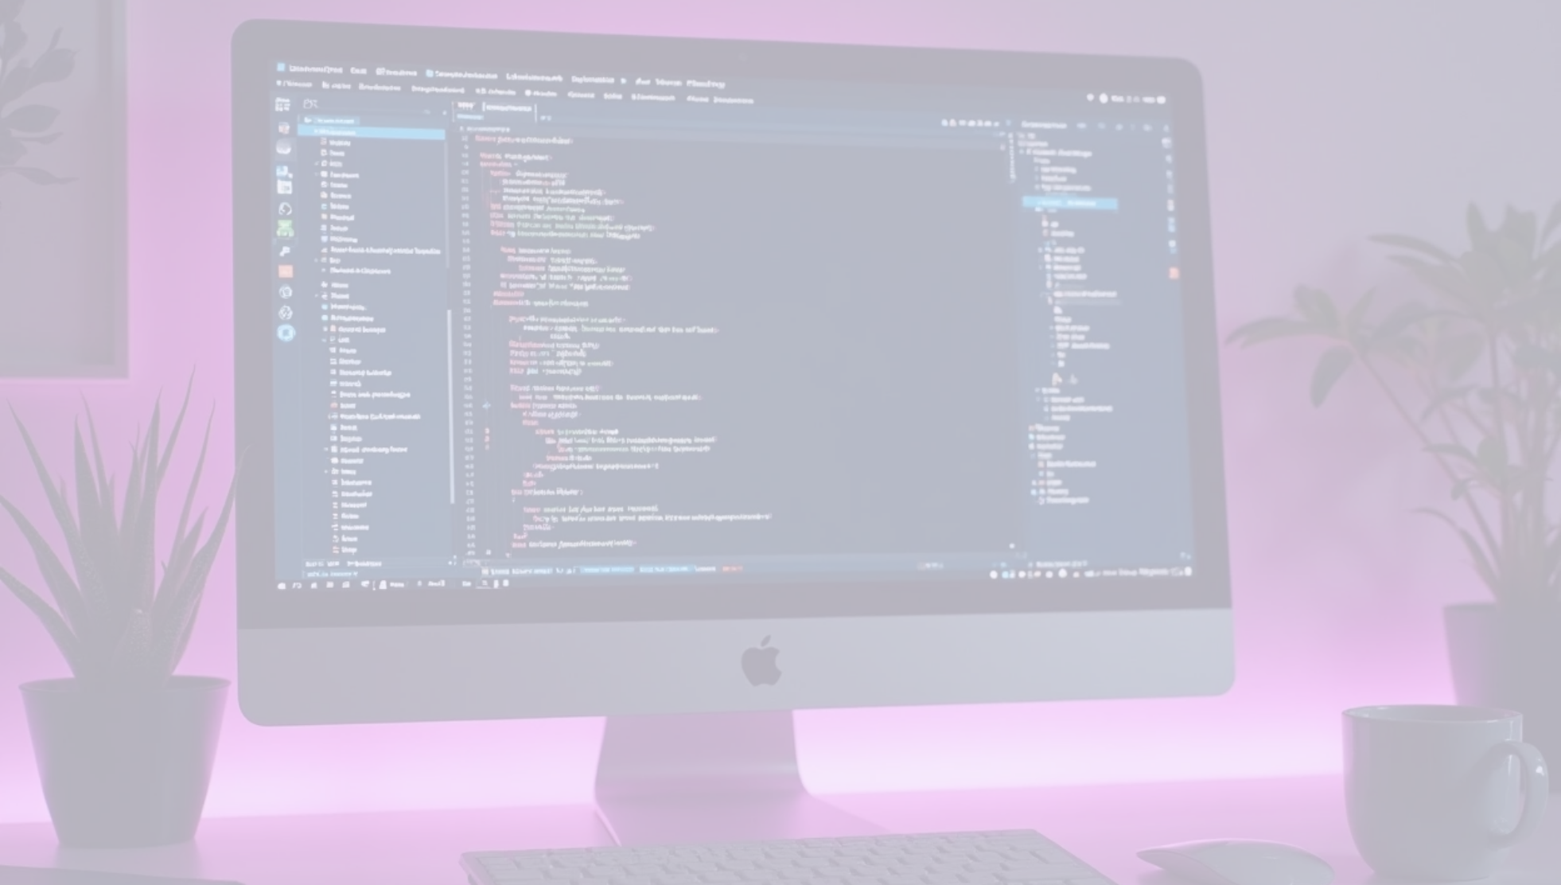
Installation & Run Guide …
How to Run Lapick Locally?
1
2
3
Clone the repository
Follow setup instructions in the repo
Git clone
https://github.com/JCKawin/Lapick.git
Make sure you have the following:
• An Internet connection
• OS installed
• A computer

Slide 7





Upcoming Features…
What’s Next for Lapick?
Integration with live e-commerce APIs
User account + wishlist system
Mobile version
Chatbot assistant

Slide 8

Thank You !
1
We’re here to help you pick your next laptop – the smart way.
2
GitHub Repo: github.com/JCKawin/Lapick

